Slide 1
Accelerator Design By Modeling
Tony Nowatzki

Slide 2
Dark Silicon
Cache
Under ITRS Scaling,
50% Dark Silicon
By 8 nm ?
Core
Core
Core
Core
Esmaeilzadeh et al.
ISCA 2011

Slide 3
What to Do?
Reduce Dark Silicon
Smaller Chips
Energy Efficient Architectures
Utilize Dark Silicon
Use “sometimes-on” component
Design Alternatives
Accelerators Do Both!

Slide 4
Multi Accelerator Design?
Cache
Core
Core
Core
Core

Slide 5
Multi Accelerator Design?
Cache
A1
A1
A1
A1
Dark Silicon Solved?
A2
A3
A2
A3
A2
A3
A2
A3
Core
Core
Core
Core

Slide 6
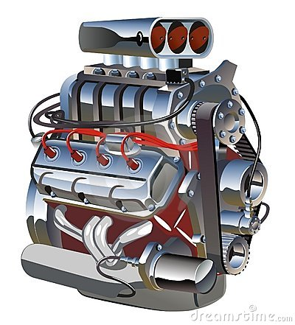
How to design accelerators?
Challenges
General Purpose vs. Specialized?
How do the interact with the core?
What program features do they leverage?
What hardware mechanisms to employ?

Slide 7
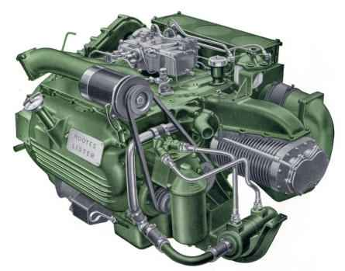
Design in Vacuum “Close your eyes and believe”
Super-Celerator
Mahlke Motors™
Speedup | Super-Celerator
Application 1 | 3x
Application 2 | 9x
Application 3 | 1x
Geo Mean | 3x

Slide 8
Design in Vacuum “Close your eyes and believe”
Super-Celerator
Mahlke Motors™
Speedup | Super-Celerator | SIMD | GPU
Application 1 | 3x | 4x | 1x
Application 2 | 9x | 2x | 100x
Application 3 | 1x | 1x | 1x
Geo Mean | 3x | 2x | 4.6x

Slide 9
Design in Vacuum “Close your eyes and believe”
Super-Celerator
Mahlke Motors™
Speedup | Super-Celerator | SIMD | GPU | Tony-Celerator
Application 1 | 3x | 4x | 1x | 1x
Application 2 | 9x | 2x | 100x | 1x
Application 3 | 1x | 1x | 1x | 3x
Geo Mean | 3x | 2x | 4.6x | 1.4x

Slide 10
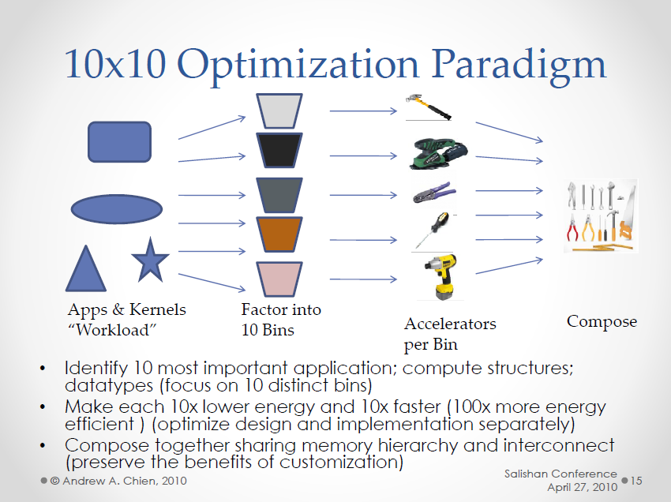
Which Accelerators?
Which Bins?

Slide 11
Our Approach: Design By Modeling
Find un-accelerated regions through use of models.
High-Level Design Proposal, and enumerate possible design decisions.
Explore the Design Space, and prune designs that don’t meet performance/energy goals
Iteratively Refine the Design, concretizing elements of the architecture incrementally

Slide 12
Step 1. Find Un-accelerated Regions
Improve Current Accelerators?
New Accelerator?
SIMD +
Scatter/
Gather?
Simplest Possible Architecture?

Slide 13
Program Structure Breakdown (by % of dynamic instructions)

Slide 14
Step 2. High Level Design Proposal Nested Loop Accelerator (NLA)

Slide 15
Step 2. High Level Design Proposal Nested Loop Accelerator (NLA)

Slide 16
A reminder:

